Slide 1




SMART HOSPITAL MANAGEMENT SYSTEM WITH IOT INTEGRATION
Under the esteemed guidance of
Dr. N . Naveen Kumar M.Tech ,
Assistant Professor
BY
R.Sujith (202G1A0450)
V.Manasa (202G1A0463)
N.Tharun (202G1A0444)
C.Vamsinath Reddy (202G1A0415)
K.Ravi Kiran (202G1A0427)

Slide 2
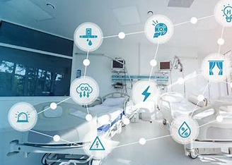
Agenda
Introduction
Existing system analysis
Proposed methodology
Diagramatic analysis
Benifits and Limitations
Project status
Conclusion

Slide 3
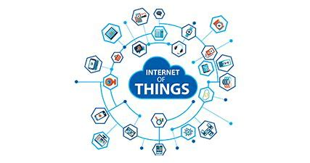
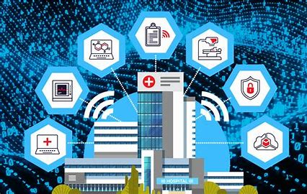


An IoT hospital management system integrates RFID tags and sensors to track patient health data. Through RFID technology, patient identification, medical history, and treatment details are stored and accessible via a web-based system. Doctors can securely access and update patient records using a IOT based interface. The system monitors vital signs such as heart rate, blood oxygen levels, and temperature, promoting standardized data management and improving healthcare efficiency. Its primary goals include ensuring data integrity, reducing inconsistencies, and enhancing patient care.
INTRODUCTION
An Overview
Tip: Use links to go to a different page inside your presentation. Links work best for pages like this one!
How: Highlight text, click on the link symbol on the toolbar, and select the page in your presentation that you want to connect.
Kindly delete this note after editing this page. Thank you!

Slide 4
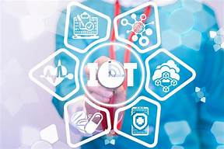
EXISTING METHOD
ARDUINO UNO
Temperature sensor
16*2 display
Power supply (3.3,5.5)v
Buzzer
Heart rate sensor
Data Entering manually

Slide 5
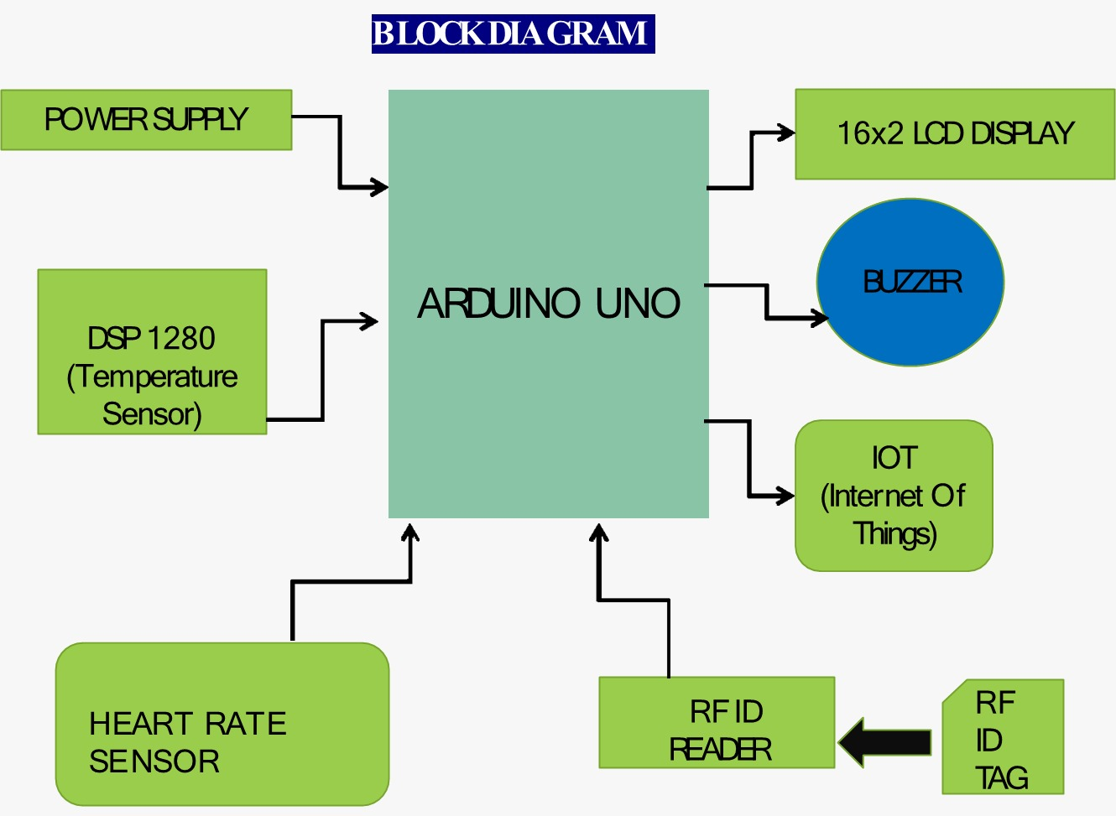
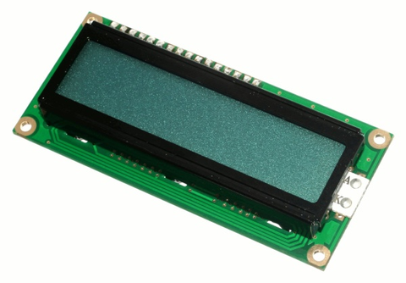
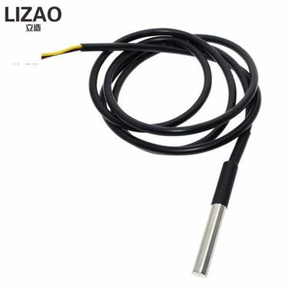
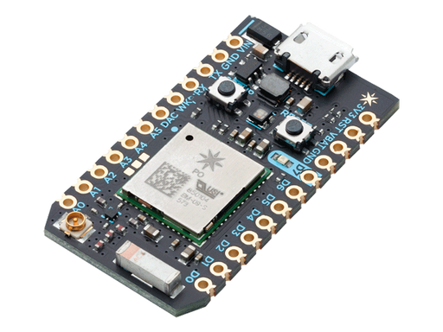
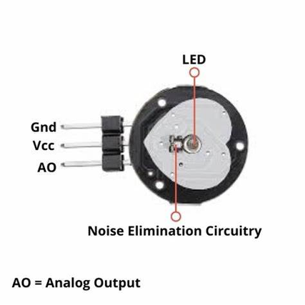
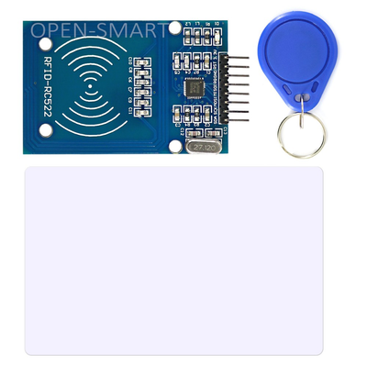

DIAGRAMATIC REPRESENTATION

Slide 6

EXISTING AND PROPOSED METHODS
The power of evaluation
EXISTING
PROPOSED
Data Integrity
Prone to Errors and Inconsistencies
Standardizing Data and Reducing Errors with IOT integration
Accessibility
Limited, Physical Records
Real-time Monitoring of Patient Health Data
RFID Tags
Not Utilized
Utilized for Automatic Patient Identification and Tracking
Efficiency
Manual Processes, May be Slow
Optimized Power Efficiency in IoT Devices
Cost
High maintainance
High intial investment

Slide 7
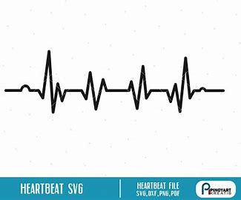
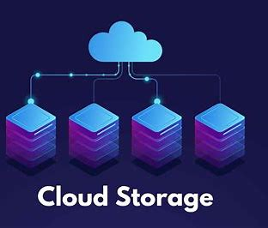
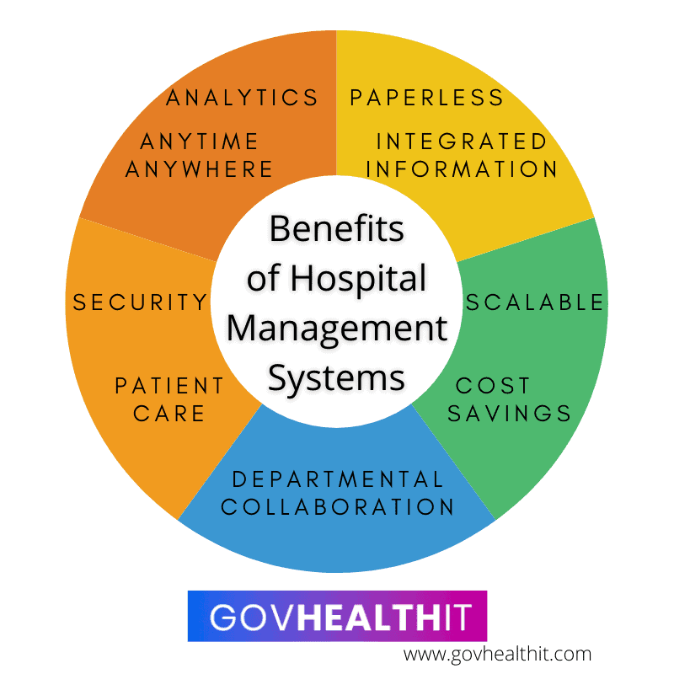
ADVANTAGES
Unlocking the benifits
Cost Savings: By optimizing the allocation of medical resources, the system helps in minimizing unnecessary expenses associated with idle time and inefficient resource allocation.
Cloud-based storage: Storing data in the cloud facilitates easy access and updates to information, ensuring the system remains up-to-date.
Remote Accessibility: Authorized personnel can access real-time information from anywhere, enabling efficient coordination and communication among healthcare staff.

Slide 8

LIMITATIONS
Data Integrity Risks: Ensuring the accuracy and integrity of biometric or RFID data poses challenges, leading to potential discrepancies in doctor availability information.
Skill Gap: Operating and maintaining the system may require specialized skills, posing challenges in regions with limited technical expertise or training resources.
Initial Investment: Implementing biometric or RFID systems, alongside the necessary infrastructure for cloud storage and IoT integration, requires a significant initial investment.

Slide 9
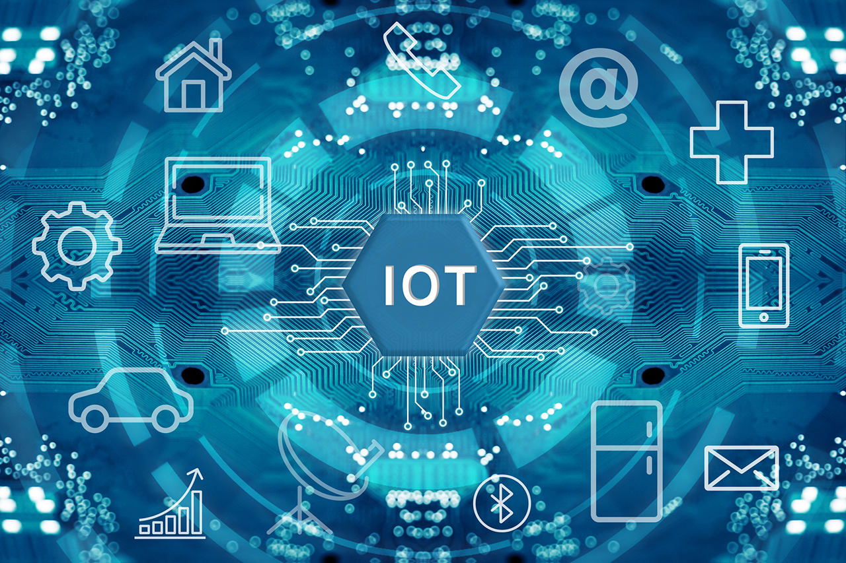
CONCLUSION
In conclusion, the integration of biometric or RFID data with cloud storage offers a promising solution to enhance efficiency and effectiveness in accessing medical assistance. By leveraging real-time data and optimizing resource allocation, this methodology represents a significant step forward in improving healthcare delivery.

Slide 10
Thank you!
.

